Slide 1
Chapter 7: MIMO Control
Chapter 7: MIMO Control
EE4265 Tutorial Solutions

Slide 2
Chapter 7: MIMO Control
Question 2
Q1(a ) - closed loop analysis
Eigenvalues of the system matrix A
as
positive eigenvalue: system is unstable at this operating condition.

Slide 3
Chapter 7: MIMO Control
Question 2
Q1(b ) – Transfer function analysis
The transfer function
The poles are the same as eigenvalues of A.

Slide 4
Chapter 7: MIMO Control
Question 2
Q1(c ) - closed loop analysis
with
Given
The eigenvalues of
are obtained from
Det(I+GG_{c})=0

Slide 5
Q2(a ) - closed loop analysis
The characteristic equation is,

Slide 6
Q2(a ) - closed loop analysis
substitute k_{c1} = 1 and k_{c2} = 5:
Is it stable or unstable?

Slide 7
Q2(b ) - re-mapping the inputs
Original mapping: y1m1 & y2m2:
New mapping: y1m2
& y2m1:

Slide 8
Q2(b ) - Now, what is the new closed loop polynomial?

Slide 9
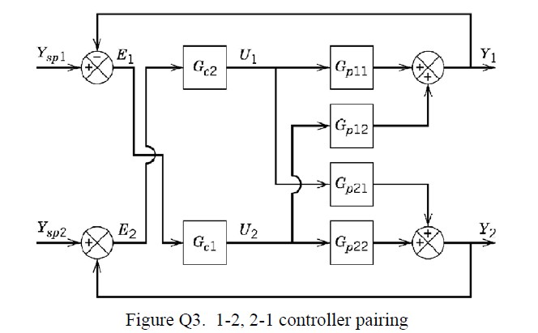
Q3 - re-mapping the inputs
Objective: derive the characteristic polynomial for this MIMO
closed loop.

Slide 10
Q3 - re-mapping the inputs
Solution:
1
Notice that gc1 tries to control y1 via gp12 and gc2 tries to
control y₂ via g_{p21}.
So, the process is,
2
3
The characteristic polynomial is,
characteristic equation
(1 +g_{c1} g₁₂) (1 + g_{c2} g₂₁) – g_{c1} g_{c2} g₁₁ g₂₂ = 0

Slide 11
Loop Pairing Analysis
Consider only SS model of the system:
y1 = k11m1 + k12m2
y₂ = k₂₁m₁ + k₂₂m₂
Define:
It is easy to find the numerator:
gain between y1and m1when all loops are open = k11

Slide 12
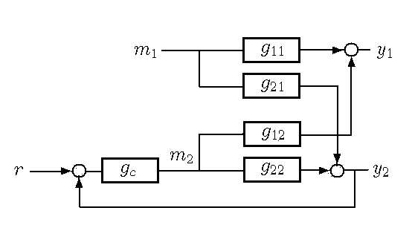
gain between y1 and m1 when all other loops closed
WHAT does this mean
gain between y₁and m₁when all OTHER loops are
closed
and HOW do we find it??
It means Loop 2 is closed.

Slide 13
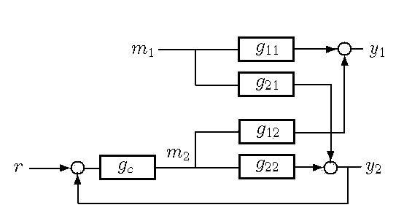
gain between y1 and m1 when all other loops closed
HOW do we find it ??: Assume loop2 is under Perfect
Control.
This means that y₂ is always 0 (no matter what!).

Slide 14
back to
λ11
gain between yl and ml when all loops are open
^{All =} gain between y and m when all OTHER loops are closed
l
l
Also,
gain between yl and ml when all OTHER loops are closed =

Slide 15
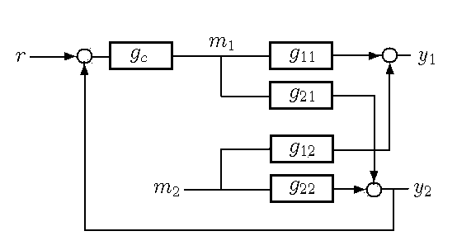
Similarly
λ12

Slide 16
RGA matrix contains the λij s
RGA defined as,
where,
Properties of RGA matrix: Sum of rows = 1, Symmetric,

Slide 17
Decide Loop Pairing
1
SS model
2
RGA
3
We can infer,
So, 1 - 1/2 - 2 pairing is fine.

Slide 18
Alternate Loop Pairing scenarios
1
RGA
1 - 2/2 - 1 is recommended. So, columns of the original
process will be interchanged
RGA
2
1 - 2/2 - 1 is recommended. So, columns of the original
process will be interchanged.
RGA
3
1 - 1/2 - 2 is recommended.

Slide 19
Controllability
Consider the steady state model of the TITO process:
Question: Without thinking about controllers or feedback, what should be the values for the inputs m_{l} and m₂ so that (for example) y_{l} = 1 and y₂ = 0?
Try to solve!

Slide 20
Controllability
Answer: We can solve for the required ml and m2 as follows:
This means that the Inverse of K must exist if we are to find
the required m_{l}, m₂. If the inverse of K does not exist, the
control of the system is impossible no matter what the controllers are.
The inverse of K exists only if the determinant |K | exists. Another way to say this is: If the rank of the 2 × 2 matrix K is less than 2, then the system is not controllable.

Slide 21
Q5(a ) - controllability
The SS model of the process is:
Question: Are the system outputs able to maintain their
set-points at steady state?
This is just another way of asking if the system is controllable.
|K | = -0.001536
So, the system is still controllable.

Slide 22
Q5(b ) - RNA, NI, κ
RGA for this process
Neiderlinski Index
Based on the RGA and NI, the pairing recommended is
1 - 1/2 - 2.

Slide 23
Q5(b ) - RNA, NI, κ
The singular values are:
The lambdas can be obtained from:
The condition number is:

Slide 24
Q5c Control Structure
λ_{ij} > 1, open-loop gain larger than the closed-loop gain - retaliatory effect from other loops acts in opposition to main effect.
Large λ_{ij}, controller gain for loop i much larger than when other loops are open, loop i to become unstable when other loops are open. Decentralized control no good.
Small determinant of steady state gain matrix of -0.001536 and large condition number k=19.85 - system is ill-conditioned, sensitive to modeling errors and decoupling will be difficult.
Better system performance can be achieved through: 1) change parameters of process; 2) design a more advanced control system such as predictive control or intelligent control, etc.

Slide 25
Loop Pairing for 3 input 2 output
Option 1:
ul, u2 are the inputs
Option 2:
ul, u3 are the inputs

Slide 26
Loop Pairing for 3 input 2 output
Option 3: u2, u3 are the inputs
The best option of the three is Option 2 because its is
closest to 1.

Slide 27
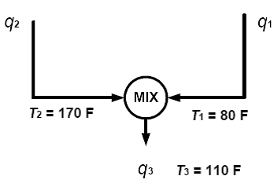
Q7 - Shower Control System
1
Mass Balance:
q3 = q1 + q2
2
Energy Balance:
This is simplfied to,

Slide 28
Q7(a ) - Shower Control System
1
SS Mass Balance:
(1)
2
SS Energy Balance:
(2)
The values for T1ss , T2ss , T3ss and q3ss are given on the diagram.
Using (1) and (2), we can solve for q_{1ss} and q_{2ss} . (Answers: 1
and 2 respectively.)

Slide 29
Q7(b ) - Shower Control System
1
The model of the system should be:
where all the symbols with the ’dash’ respresent deviation
variables and all the K s are pure gain.
From mass balance, it is clear that,
2

Slide 30
Q7(b ) - Shower Control System
1
To find Kll and Kl2, we will need to linearize the energy
balance:
Using Taylor’s approximation,

Slide 31
Q7(b ) - Shower Control System
1
The gain matrix is,
2
The RGA matrix is,
Thus, recommended pairing is:

Slide 32
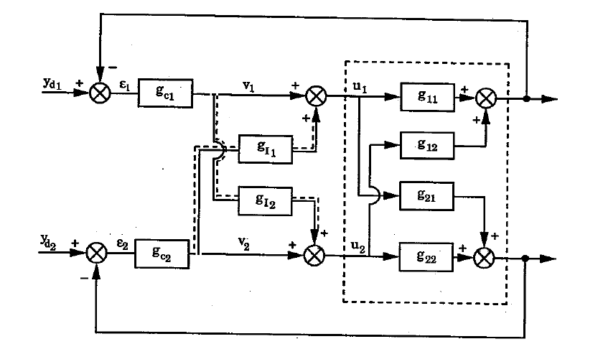
Simplified Decoupling
ul = vl + gI lv2
u₂ = g_{I 2}v_{l} + v₂

Slide 33
Simplified Decoupling
What would you choose for gI l and gI 2? What is our
Objective?

Slide 34
Simplified Decoupling
Objective: We would like interaction terms to be 0.
So, choose:
Then, what is the resulting system?

Slide 35
Simplified Decoupling
What is the resulting system?
The controllers should be designed for:

Slide 36
Simplified Decoupling
The given process:
The decouplers are:
We just have to ignore the prediction term.

Slide 37
Alternate example
The given process:
The decouplers are:
The modified process:

Slide 38
Add delays to the process input
The Implementable decouplers are:

Slide 39
Advantages/Disadvantages
1
Advantages:
1
The resulting process has no interaction terms. Hence,
excellent tracking performances.
2
Disadvantages:
1
More complicated controller design. (Without decoupler, we
could just design g_{cl} for g_{ll} & g_{c2} for g₂₂ .) Addition of extra delays sometimes.
2

